Slide 1
Biodiversity Project
Data Analysis and Some Conclusions

Slide 2
About the Data
Data was collected on 5824 species in 4 National Parks
Observations were carried out by Park Service employees and volunteers over the spring, summer and fall of 2017
Vascular plants are the most heavily represented category of species, with birds and non-vascular plants in a distant second and third

Slide 3
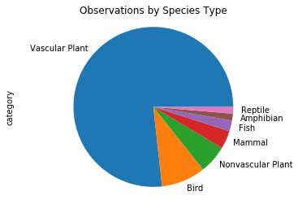
Observations by Species

Slide 4

Endangered Status: Definitions*
Species of Concern: [A species] that is experiencing, or formerly experienced, serious (noncyclical) population declines or range retractions (not reversed) that, if continued or resumed, could qualify it for threatened or endangered status.
Threatened: Any species that is likely to become an endangered species within the foreseeable future throughout all or a significant portion of its range.
Endangered: Any species in danger of extinction throughout all or a significant portion of its range.
In Recovery: A species for which the trend toward threatened or endangered status is for the time being reversed.
*from the United States Fish and Wildlife Service

Slide 5


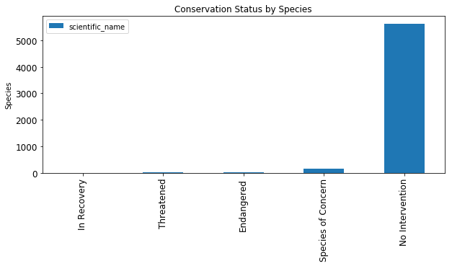

Good News
Many species are thriving (N = 5633)

Slide 6
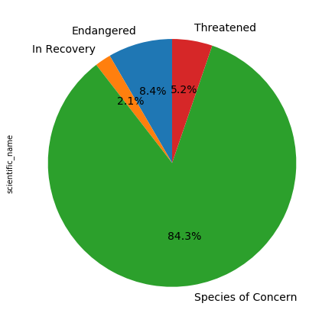
Current Trends For Other Species
Trends
Proportions of statuses
Analysis of this data suggests that while relatively few species are in danger (threatened or endangered) at this time, very few are in recovery and many are headed toward threatened status at this time.
Since more information is needed about “species of concern”, more resources should be directed toward gathering information specifically about these species.

Slide 8
Which Types of Species Are More Likely to be Endangered?
We looked at which categories of species are most likely to be in protected.

Slide 9
Endangered Mammals
As a proportion of type, mammals are most likely to have a protected status.

Slide 10
Comparisons
When we compare mammals versus other categories:
They are significantly more likely to have protected status than reptiles (p < .025)
They are somewhat more likely to be endangered than amphibians (p < .10)
Birds are somewhat more likely to be endangered than reptiles (p < .10) and should remain of concern to conservationists.

Slide 11
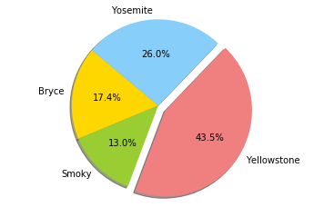
Specific Case: Wild Sheep
Sheep
Observation Locations
Sheep are one subcategory of mammal our researchers have been observing over the past year.
Observations have been done at four (4) National Parks.
The majority of observations were done at Yellowstone Park.

Slide 12


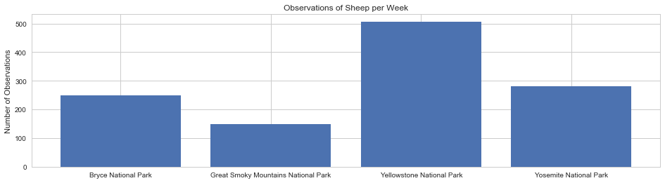
Health of Park Sheep
One motivation for tracking park sheep is to control diseases in the population.
Hoof and mouth disease has been of concern to park conservation staff and research zoologists.

Slide 13
Foot and Mouth Disease Prevention
We are tracking a new prevention program.
Observations suggest that a baseline of15% of park sheep species have the disease.
We seek a minimum detectable effective of 5% reduction in that proportion.

Slide 14
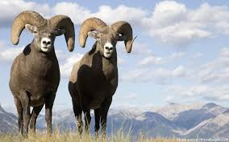
Foot and Mouth Disease Prevention
The number of weeks needed at each park to observe a sufficient number of sheep is as follows:
Bryce: Approximately 2 (2.04)
Yellowstone: Approximately 1 (1.01)
Yosemite: Approximately 1 Week, 6 Days (1.81)
Great Smoky Approximately 3 and ½ Weeks (3.4)

Slide 15
End Notes
Data Supplied by Code Academy
Definitions from CA and US Departments of Fish and Wildlife
Data processed with Jupyter Notebook iPython and Seaborn
Two charts made with Excel (due to time constraints.)
Thank you.
Nancy Melucci PhD
Data-Scientist Elect

